Slide 1
IMBALANCED BANKING DATASET
Exploring the challenges and solutions in dealing with imbalanced banking datasets.
MANASHWY PADHI (2348528)
BAMMIDI ABHINAV (2348508) NANDITHA.S (2348536)
Department of Computer Science)
Christ (Deemed-to-be-University
Banglore, India

Slide 2
Scaling and Distributing
To ensure uniformity, we will scale the columns representing Time and Amount along with the other columns. Additionally, we will create a sub-sample of the dataframe that includes an equal number of Fraud and Non-Fraud cases. This balanced approach will assist our algorithms in effectively identifying patterns that determine the fraudulent nature of a transaction
Subsample will be a dataframe with a 50/50 ratio of fraud and non-fraud transactions.
Issues of using original dataframe:
Overfitting: Our classification models will assume that in most cases there are no frauds! What we want for our model is to be certain when a fraud occurs.
Wrong Correlations: Although we don't know what the "V" features stand for, it will be useful to understand how each of this features influence the result (Fraud or No Fraud) by having an imbalance dataframe we are not able to see the true correlations between the class and features.

Slide 3
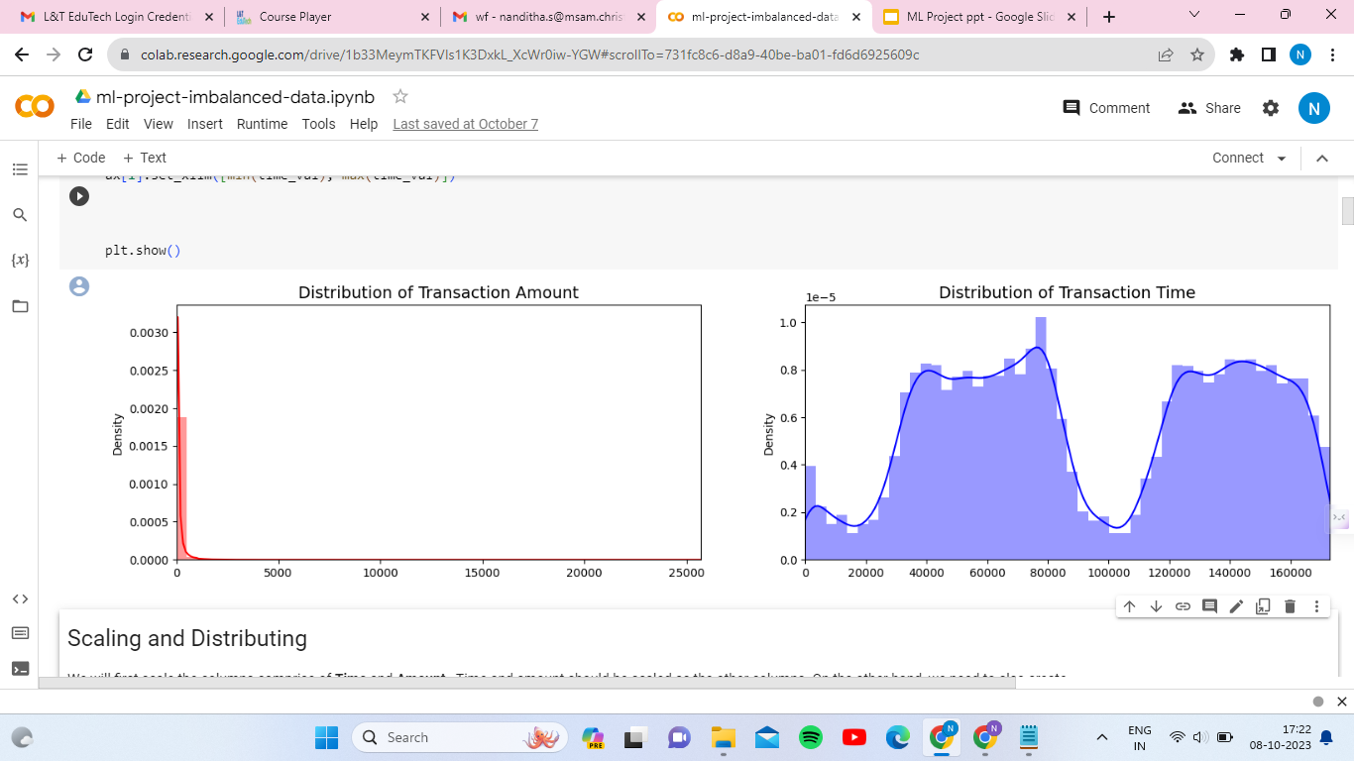
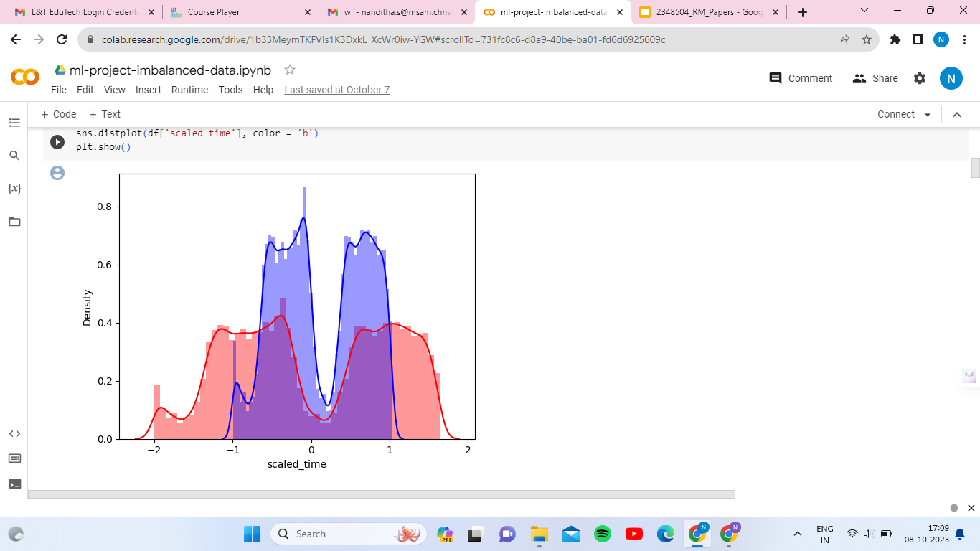
Scaled amount and scaled time are the columns with scaled values.
There are 492 cases of fraud in the dataset so that can randomly get 492 cases of non-fraud to create our new sub dataframe.
We concat the 492 cases of fraud and non fraud, creating a new sub-sample.

Slide 4
Why Robust Scaler is good?
The Robust Scaler uses the interquartile range (IQR) as a robust statistical measure. It scales the data based on the IQR, minimizing sensitivity to outliers.
To achieve robustness, the Robust Scaler subtracts the median (a robust measure of central tendency) and divides by the IQR. This normalization process ensures that extreme values have less influence on the scaled data.
By effectively reducing the impact of outliers, the Robust Scaler provides more reliable scaling for analysis and modeling purposes.
The Robust Scaler is less affected by outliers, uses the IQR for scaling, subtracts the median, and divides by the IQR, resulting in less distortion of extreme values and improved suitability for analysis and modeling.
X_{scaled} = {X - X_{median}}
{IQR}

Slide 5
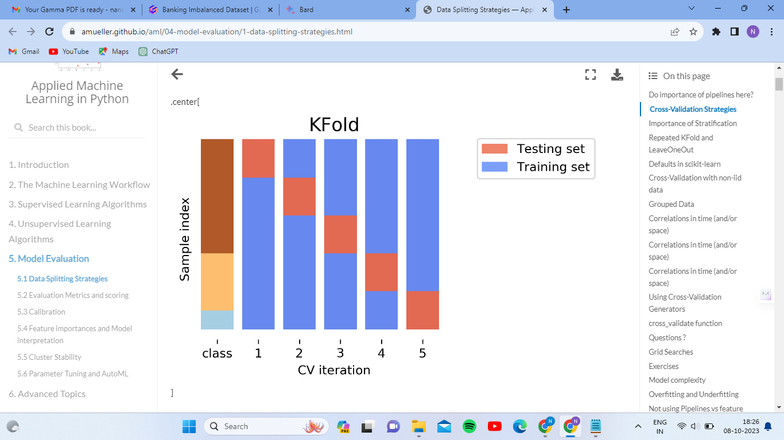
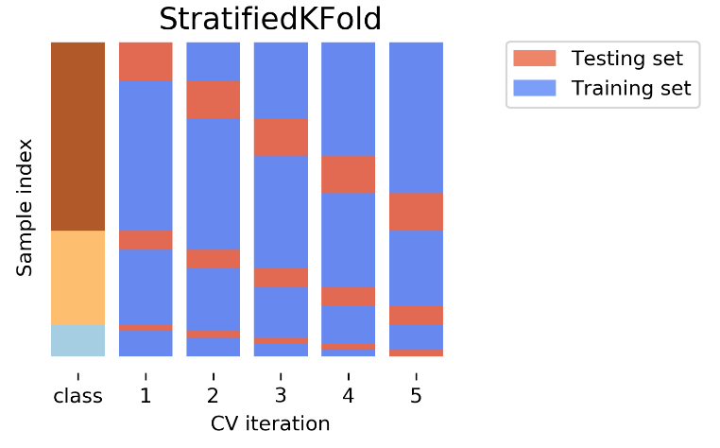
Splitting the Data
K-fold cross-validation is a technique used for model evaluation and selection. It involves dividing the dataset into k subsets or folds of roughly equal size. The process then iterates k times, with each fold being used as a validation set while the remaining k-1 folds are used for training the model.
Stratified k-fold ensures that each fold maintains the same class distribution as the original dataset, reducing the risk of biased evaluation results. K-fold divides the dataset into k subsets for training and validation, while stratified k-fold maintains the class distribution in each fold, making it suitable for imbalanced datasets.

Slide 6
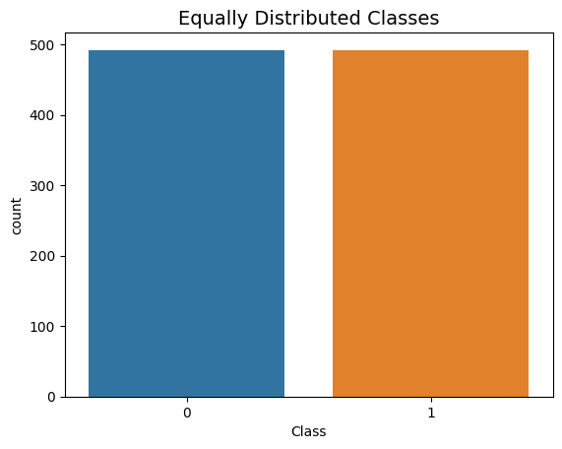
Random Under-Sampling:
Consists of removing data in order to have a more balanced dataset and thus, avoid our models from getting overfitting.
Find out how imbalanced our dataset is and then bring the non-fraud transactions to the same amount as fraud transactions, 492 in this case.
As we can see from the graph, both the classes are balanced after applying Random Under-Sampling

Slide 7
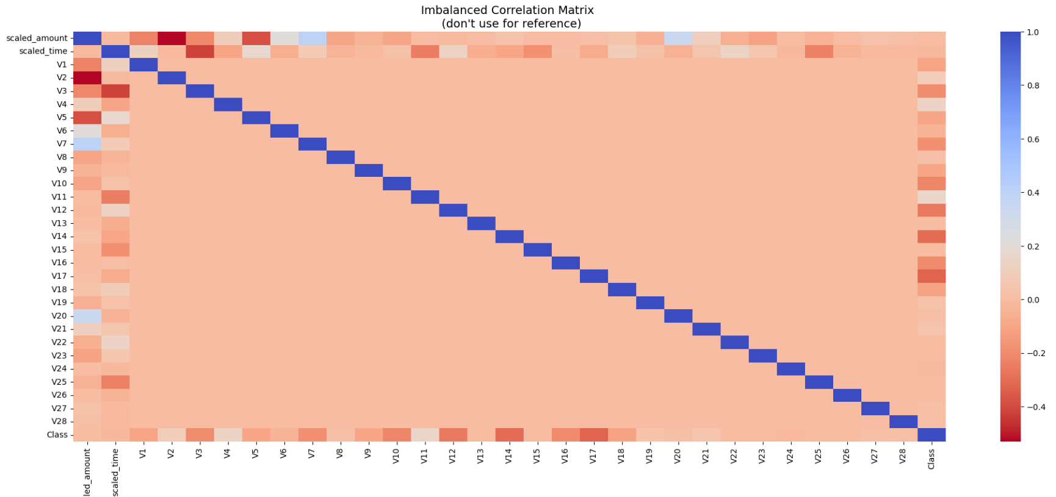
Correlation Matrices
Correlation matrices are the essence of understanding our data.
We want to know if there are features that heavily influence in whether a specific transaction is fraudulent or not.
It is very important that we use the correct data frame, in this case the sub-samples in order to see which features have high positive or negative correlation with regards to fraudulent transactions.

Slide 8
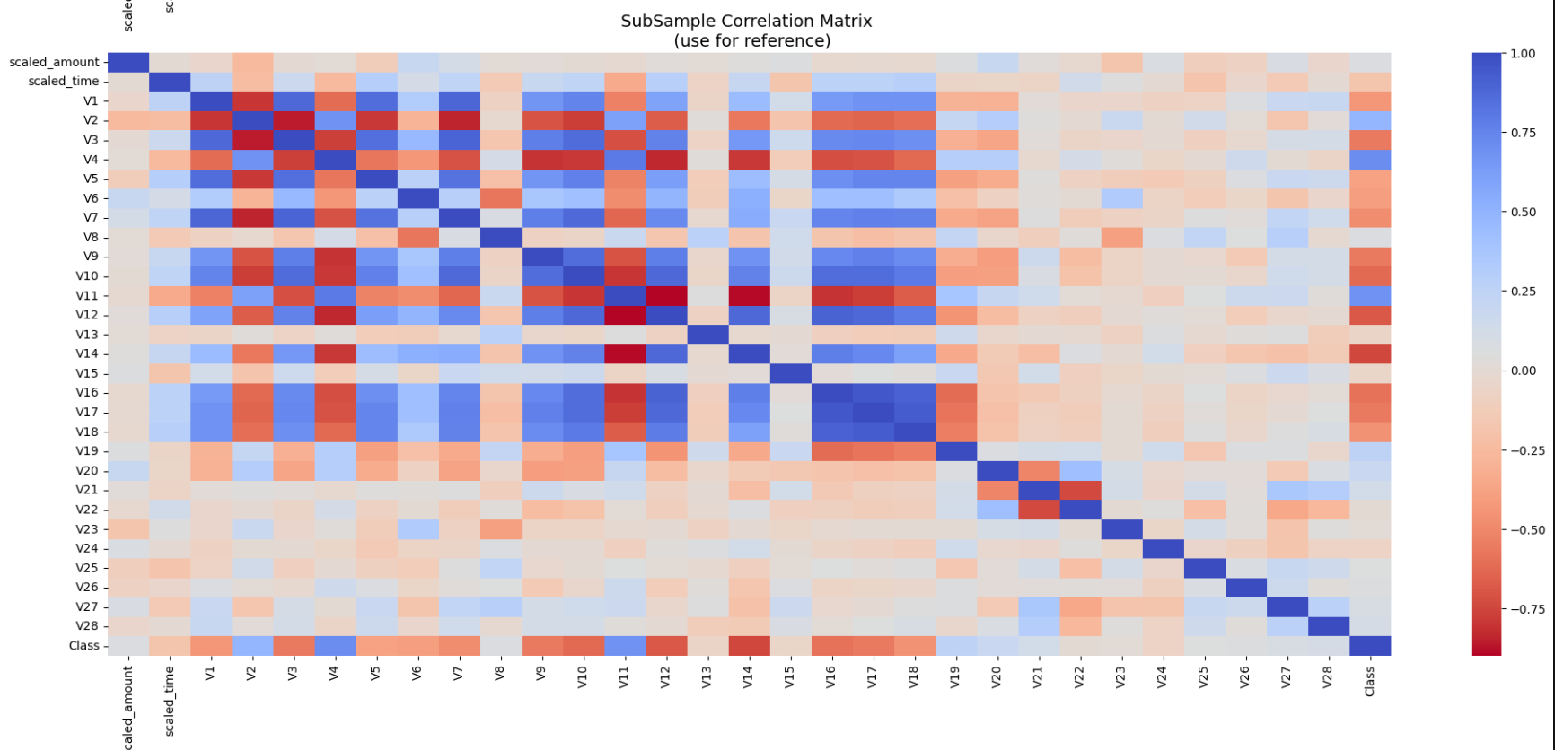
As we can see, there are only a few features that are correlated to in the imbalanced dataset, and the heatmap is effectively empty.
It is evident from this heatmap that there is a lot of correlation. We are effectively looking for regions that are ‘blue’ which signifies the correlation (1.0)

Slide 9
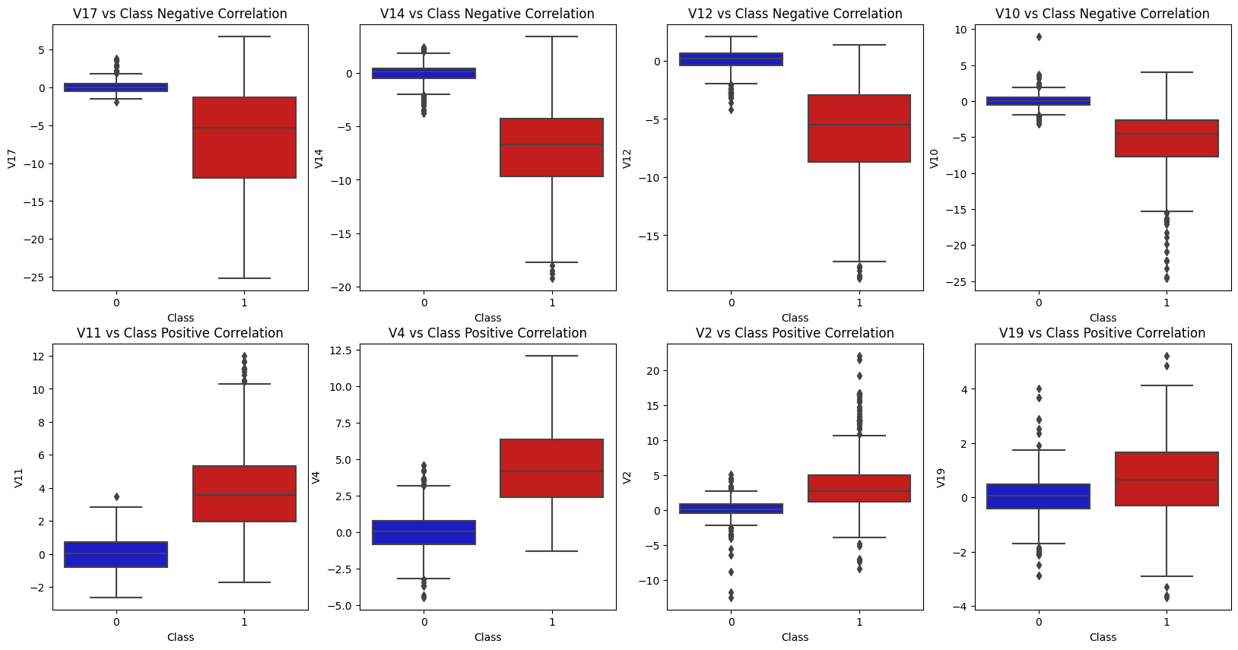
Summary:
Negative Correlation: V17, V14, V12, an V10 are negatively correlated.
Positive Correlation: V2, V4, V11, and V19 are positively correlated.

